Slide 1


BabySafe™
How a Smart Bassinet can Save Lives
Presented by: Craig Fleischman, Thom, Alena
BabySafe™ Solutions, Inc.
Association of Maternal & Child Health Programs
December 12, 2018
Notes:
[Craig - :50 mins: Audience identified, Team introduction provides knowledge & Confidence Expertise, plus introduction of domain topic, grabs audience attention with “Saves Lives”]
--------------------
Good evening. In our presentation -- BabySafe: How a Smart Bassinet can Save Lives, we will announce a breakthrough in how data science and safe-technology can provide a friendly, unobtrusive way to monitor babies once they have left the care of the hospital.
Before I go any further, I would like to introduce our BabySafe team. First, our Chief Data Officer, Doctor McLucas. Next, Doctor Hamnett, who is our Chief Medical Officer. And myself, Craig Fleischman the CEO of BabySafe. We are pleased to present to the Association of Maternal & Child Health Programs on the future of infant care --
-- And share with you an advancement that we believe will be a staple of all infant well-care programs, giving new parents confidence and healthcare providers more capabilities for their patients.

Slide 2
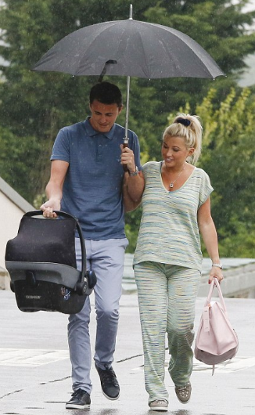
Parents + 1: A Forever Changing Event
The Joy of Parenthood
Impact on Parents Sinks in
The Baby Manual is Lost!
Notes:
[Craig - 1:05 mins: Paint a story, increase audience acceptance of the product and Tom; Highly skilled professional and new parent → can relate to target audience and has the respect of the healthcare industry.]
--------------------
All of us in the room know what it is like to support parents as they transition into becoming new parents. They have a wide spectrum of emotions from excitement, to some fear and anxiety, and potentially depression which impacts up to 20% of parents. The family leaves the hospital, a very confident environment, to their familiar, yet unproven home, and with themselves as unproven parents, and with no Baby manual on the bookshelf.
Instead of hearing this from me, let me ask Dr. Hamnett to say a few words. Dr. Hamnett is not only a new Parent and uses BabySafe, but is an award winning author and is a regular contributor to the New York times.
<< TOM IN >>
Thank you Craig. When my wife and I brought our baby home, even as a medical professional, I felt the insecurity and uncertainty of caring for a newborn. When we started using BabySafe, its diagnostic output and real-time information helped our family gain confidence in coping and allowed us to more fully experience the joy of parenthood. Now let me turn it back over to Craig to tell you more about our research.
<< TOM OUT >>
Thanks Dr. Hamnett.

Slide 3
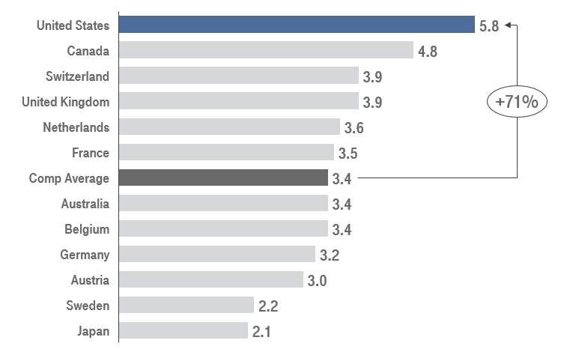
Can Infant Health Outcomes be Improved at Home?
Infant Mortality Rate (per 1,000 live births), 2014
Source: Centers for Disease Control and Prevention
Notes:
[Craig - :35 mins: US Lags postnatal mortality]
--------------------
As you can see from the graph, unfortunately, the United States’ infant mortality rate is 71% higher than the average for comparable countries.
This lead us to our research question, “Can Infant Health Outcomes be improved at Home?”
Now, I know, this research question raises additional inquiries such as:
Can an infant's vital signs be successfully monitored by parents?
Is the technology safe?
Will the solution hinder or help infant care and parent stability?
Throughout the presentation we will be unpacking these questions.

Slide 4
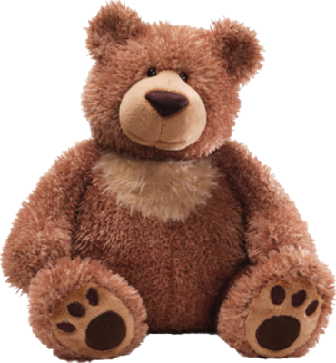
Can Infant Health Outcomes be Improved at Home?
Target Audience: Expecting parents
Adult Health
Commonplace technology
Many devices available
Biometric monitoring
$29B US revenue
GAP
Infant Health
Rudimentary technology
Limited to no devices available
Video & Audio monitoring
$1.2B US revenue
Notes:
[Craig - 1:15 mins: research question and target audience identified, acknowledge of outstanding questions, status of tech domain shared, and linkage to common technology in use today. BabySafe is the solution to the GAP]
--------------------
Our Primary audience that we are targeting is expecting parents. That is where we focused and spent the majority of our effort, but we were also aware of our secondary audience: Hospitals and Insurance Companies.
Today, the state of Data Science and health technology is in two camps: the Haves and the Have Nots.
<< CLICK: Adult Health bullets appear>>
Health-tech is common place for adults. Almost everything imaginable can be monitored from your health vitals such as heart rate, weight, sleeping and even your golf swing. The expected US growth rate of health wearables is 20% per year becoming a 29 billion dollar market by 2022.
<< CLICK: Infant Health bullets appear>>
Now let’s take a look at Health-tech for infants at home. The application of technology is lagging. There have been recent entries with device anklets, but the majority of the market uses audio and video monitoring. And sometimes wrapped inside of a stuffed animal. The estimated US revenue is 1.2 billion dollars per year by 2020.
<< CLICK: GAP & Bear appear>>
BabySafe fills this gap by leveraging the existing, safe, and reliable foundation from the fitness tracking industry, and customized with unobtrusive monitoring that addresses the need of parents, healthcare professionals, and most importantly infants.
Now, I would like to turn it over to our Chief Data Officer, Dr. McLucas.

Slide 5
How Does BabySafe™ Keep Baby Safe?
Collection
Analysis
Decisions
User input
Medical history
Demographics
Diet
Sensory input
Video
Audio
Scale
Gyroscope
Radio wave receiver
Infrared scanner
Notes:
[Alena - 0:26mins: data collection + variety]
How does BabySafe actually keep baby safe? First, it collects a large variety of data. A user inputs parent and baby medical histories, demographic data, and optionally diet can be tracked. The bassinet sensors include video, audio, a scale (to measure weight), a gyroscope (to understand baby motion), a radio wave receiver (to detect breathing and heart rate), and an infrared scanner (to measure temperature).

Slide 6
How Does BabySafe™ Keep Baby Safe?
Collection
Analysis
Decisions
User input
Medical history
Demographics
Diet
Sensory input
Video
Audio
Scale
Gyroscope
Radio wave receiver
Infrared scanner
Detect physical changes
Bassinet movement
Iterative approach
Notes:
[Alena - 0:32mins: data analysis, anomaly detection, classification models, iterative, design thinking]
BabySafe takes this data and analyzes it using robust machine learning models. To build trust with parents, BabySafe’s algorithm has been trained in hospitals under the advisement of medical professionals. We use the latest anomaly detection techniques in order to identify ‘abnormal’ baby behavior from sensor input. In addition to medical discovery, it uses classification models to determine bassinet movements that soothe versus upset baby. We have an iterative approach to modeling, as we use design thinking to ask the right questions and close the information gaps that save lives.

Slide 7
How Does BabySafe™ Keep Baby Safe?
Collection
Analysis
Decisions
User input
Medical history
Demographics
Diet
Sensory input
Video
Audio
Scale
Gyroscope
Radio wave receiver
Infrared scanner
Detect physical changes
Bassinet movement
Iterative approach
Health alerts
Intervention advised
Health recommendations
Changes to consider
Regular reports
Long-term insights
Notes:
[Alena - 1:24mins: decision-making, different levels of urgency]
BabySafe has the diagnostic tools that help parents better detect whether their baby is showing any behavior that is cause for concern by providing three tiers of information to guide different kinds of decisions. It’s important to note that BabySafe cannot and does not require parents to take action. They can always choose to maintain the status quo by not implementing BabySafe’s recommendations.
The first tier of information is a health alert, triggered by an urgent physical concern. Baby requires either immediate attention from a parent or medical professional. For example, if baby loses half a pound in a short period of time, BabySafe will send a text, phone notification, or email. Health alerts enable early detection, so parents can decide to take baby to the doctor when symptoms are just beginning.
BabySafe also provides health recommendations that are non-urgent. If it notices sleep restlessness, it will suggest the best time for baby to sleep so cycles regulate. Health recommendations advise parents of moderate irritation and suggest ways to improve baby’s everyday experience.
Lastly, parents can receive a weekly or monthly report with summary statistics on weight, sleep, irritation, crying, and more. Regular reporting gives parents access to all of baby’s information so they can always reference long-term trends, as parents own baby’s data.
From collection to analysis to decisions, we bring you BabySafe.

Slide 8


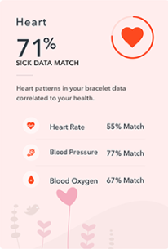

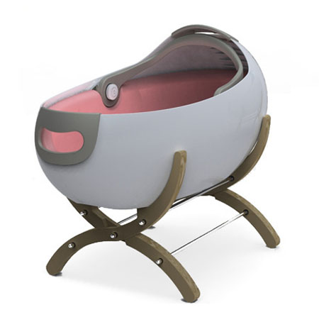
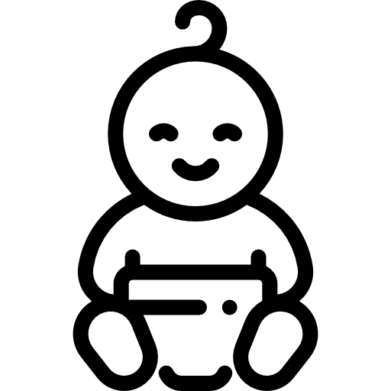
BabySafe™
Notes:
[Alena - 0:41mins: bassinet + app, cloud platform, conveying findings]
BabySafe’s AI-powered health monitoring delivers better health outcomes via its safe, sensor-enabled bassinet, mobile app and secure cloud platform. Our bassinet collects the sensory data, using it for early detection of physical health and learning how to soothe baby.
The data is always available via web and mobile apps, and our team puts extra focus on user experience. We know that to resonate with parents and health professionals alike, our interface must be intuitive, expressive, simple, and straightforward. Our best-in-class user interface promotes engagement and results in a more empowered, confident parent.
I now invite Dr. Hamnett to address compelling ethical questions that surround health care for infants.

Slide 9
Better Health Outcomes, Highest Ethical Standards
Persuade through fact and feeling
Fact: Controlled studies
Feeling: Learn about your baby
Manage risk proactively
Data is secure and not for sale
Overcoming ambiguity bias
“First, do no harm”
Notes:
[Tom] New parents desire to both protect and connect with baby. These desires form our communication approach to new parents. First, BabySafe’s health claims are supported by fact. We highlight to new parents controlled studies showing better health outcomes for babies using BabySafe. Second, we persuade through feeling. We demonstrate to new parents the insights about baby they can learn through BabySafe. Parents learn about their child’s favorite rocking motions and soothing sounds - allowing parents to connect with their healthy, calm baby.
We also realize there are several risks this technology poses - and we address these directly and proactively. First, data security is paramount. BabySafe leads the industry in ethical data stewardship - we use industry-leading security and we never use your data for *any* purpose outside of this product.
Next, a risk exists that parents conflate BabySafe’s detailed information with certainty in results, which could lead to ambiguity bias - parents may trust BabySafe over common sense due its detailed analysis. To combat this, we make it clear to parents that BabySafe is not a nanny and not a doctor, and any medical alert is coupled with a prompt to consult your doctor.
We at BabySafe take the Hippocratic Oath seriously. And in the emerging field of data science, we apply the same principles. We think through unintended consequences of our product to mitigate this risk, and our mantra in medicine and data science is the same: “First, do no harm”

Slide 10
A Bright Future for BabySafe™ and Data Science
Follow-on Questions
What are the downsides?
Can it promote development?
Can it be extended to other groups?
Better baby wellness through data science - with real-world impact
Thank You For Your Consideration of BabySafe™
Notes:
[Tom] This technology is exciting, and it naturally leads to several follow-on questions. Some of these include:
What are downsides? (In the 1970s, when seatbelt laws went into effect, auto fatalities were found to decline but accidents went up - leading some to wonder if drivers were more reckless due to the feeling of safety provided by the seatbelt. We imagine BabySafe might inspire a similar false sense of security with baby)
Can this tech help outcomes other than baby health? For instance, can BabySafe promote learning development in newborns?
Can this technology be extended to other groups (toddlers, nursing homes, special needs individuals?)
Overall, we see a bright future ahead for BabySafe and the advances it represents. By leveraging data science, BabySafe is able to improve baby wellness in ways that do not exist today. We can save lives, improve health, and reduce stress.
At the beginning of this presentation, we told you that there is no Baby Manual. And that’s true. But with BabySafe, new parents are given the timely, accurate information they need to start writing the manual for their Baby themselves.
We invite you to share the BabySafe story with your medical and parental members, and thank you for your time today.

Slide 11
Questions

Slide 12
Acknowledgements
Research Papers
Dr. Tom Hamnett -- The Smart Bassinet
Dr. Craig Fleischman -- The Smart Home

Slide 13
References
Slide Deck:
https://www.statista.com/statistics/742448/global-fitness-tracking-and-technology-by-age/
http://www.amchp.org/Calendar/Conferences/amchp-conference/Pages/default.aspx
https://www.ncbi.nlm.nih.gov/pmc/articles/PMC4856058/
https://www.alliedmarketresearch.com/baby-monitor-market
https://www.smartinsights.com/digital-marketing-strategy/wearables-statistics-2017/
https://www.forbes.com/sites/paullamkin/2018/02/22/smartwatch-popularity-booms-with-fitness-trackers-on-the-slide/#7ed4a5327d96
Images:
http://www.plioz.com/cascara-modern-bassinet-can-give-a-unique-and-stylish-look-to-any-nursery/
https://mockuphone.com/#ios
https://www.flaticon.com/free-icon/baby-boy_941515#term=baby&page=1&position=1
http://www.smchd.org/2017/07/vaccines-best-shot-good-health/infants-immunization_1/

